Slide 1

Title Layout
PRESENTATION
MUSIC STORE ANALYSIS
ROHIT YETRE

Slide 2

“A music store is seeking to pinpoint crucial factors that can aid in boosting its business, diagnosing issues within the current business landscape, recognizing high-value customers, and gaining insights into new promotions and initiatives. We all employ SQL to address these challenges.”
INTRODUCTION
MUSIC STORE ANALYSIS

Slide 3

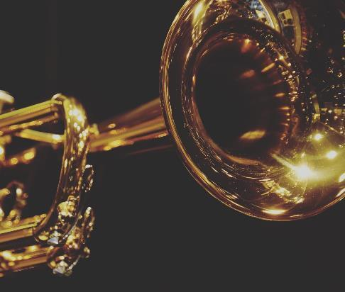
QUERIES ARE DIVIDED
INTO THREE CATEGORIES
EASY
MODERATE
ADVANCED

Slide 4

MODERATE QUERIES
EASY QUERIES
USING SIMPLE QUERIES AND JOINS

Slide 5
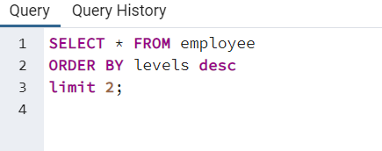
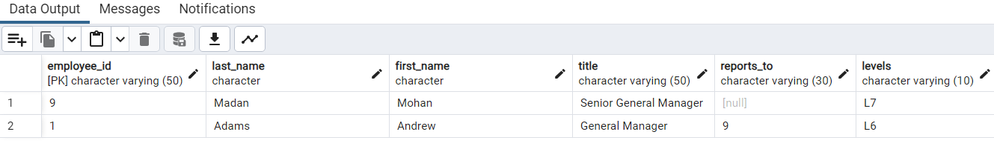
QUE NO- 1
Q.1 Who is the senior most employee based on job title?

Slide 6
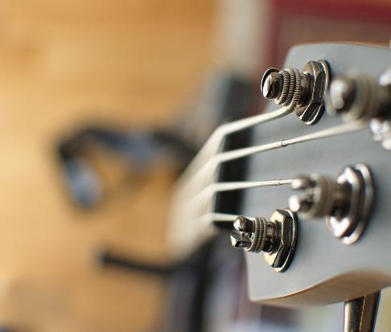
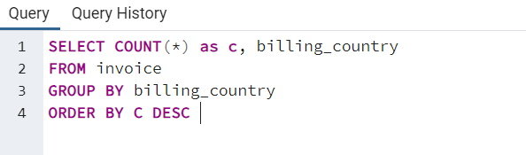
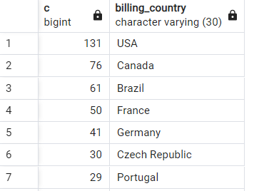
QUE NO- 2
Q2.Which countries have the most Invoices?

Slide 7
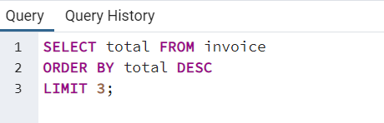
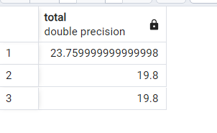
QUE NO-3
Q3: What are top 3 values of total invoice?

Slide 8
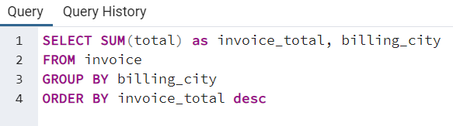
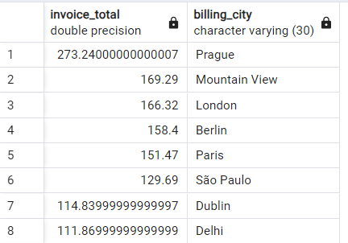
QUE NO-4
Q4: Which city has the best customers? We would like to throw a promotional Music Festival in the city we made the most money.
Write a query that returns one city that has the highest sum of invoice totals. Return both the city name & sum of all invoice totals

Slide 9
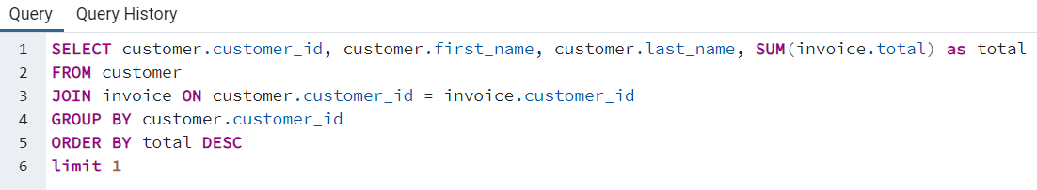

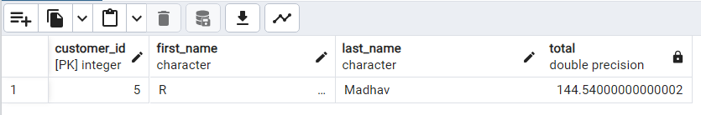
QUE NO-5
Q5: Who is the best customer? The customer who has spent the most money will be declared the best customer.
Write a query that returns the person who has spent the most money.

Slide 10
MODERATE QUERIES
MODERATE QUERIES
USING CTE QAND JOINS

Slide 11
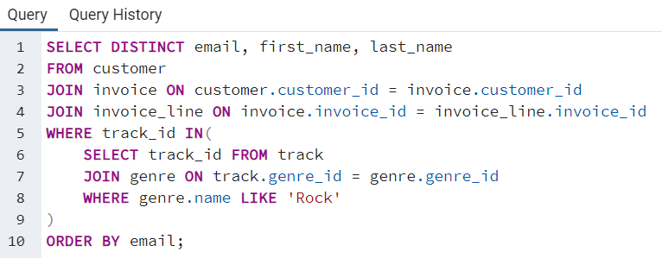
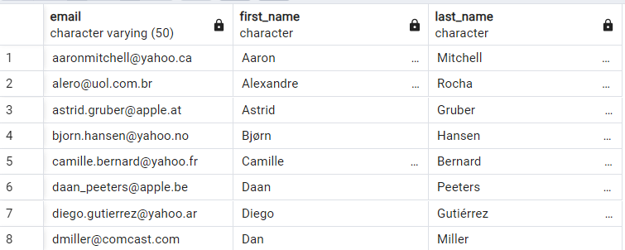
QUE NO-1
Q1: Write query to return the email, first name, last name, & Genre of all Rock Music listeners.
Return your list ordered alphabetically by email starting with A

Slide 12
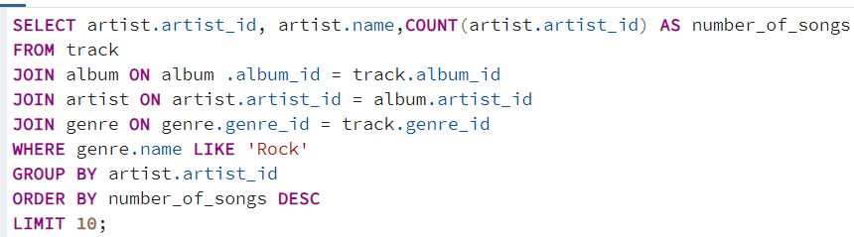
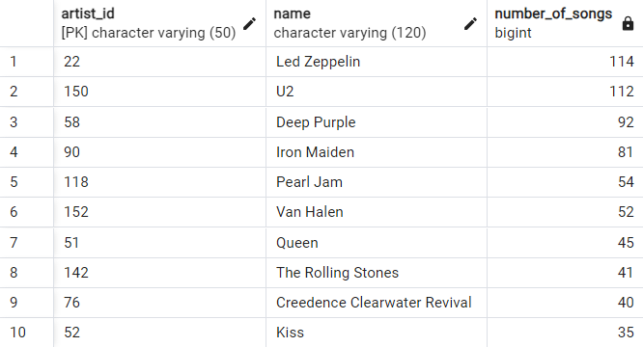
QUE NO-2
Q2: Let’s invite the artists who have written the most rock music in our dataset.
Write a query that returns the artist name and total track count of the top 10 rock bands

Slide 13
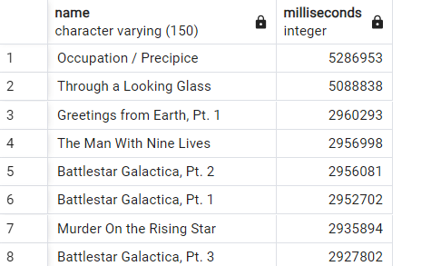
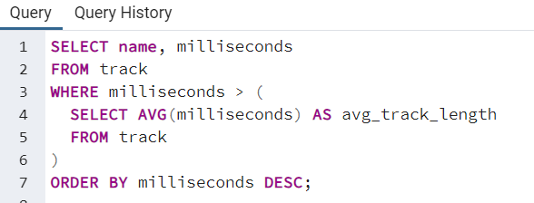
QUE NO-3
Q3: Return all the track names that have a song length longer than the average song length. Return the Name and Milliseconds for each track.
Order by the song length with the longest songs listed first

Slide 14
ADVANCE QUERIES
ADVANCE QUERIES
COMPLEX QUERIES AND JOINS

Slide 15
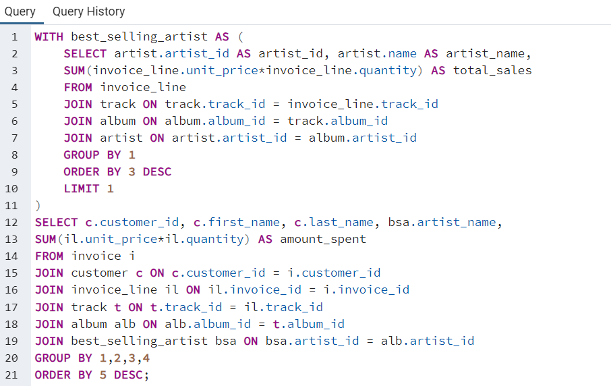
QUE NO-1
Q1: Find how much amount spent by each customer on artists?
Write a query to return the customer name, artist name and total spent

Slide 16
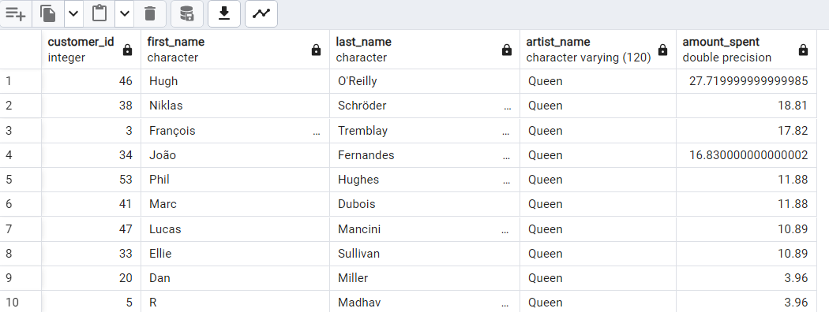
Q1: Find how much amount spent by each customer on artists? Write a query to return the customer name, artist name and total spent
OUTPUT

Slide 17
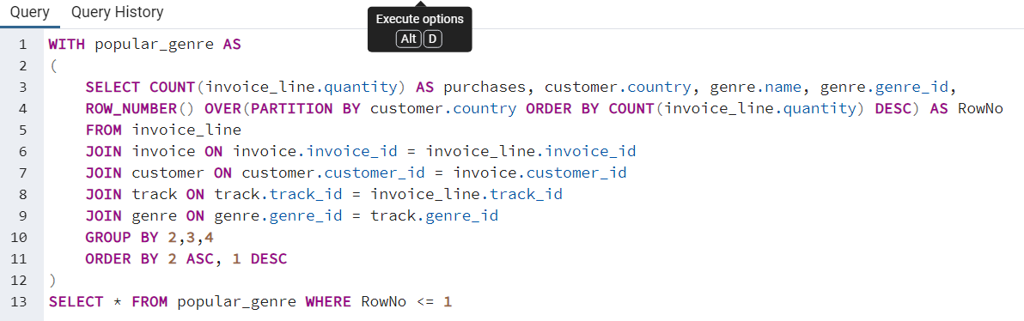

QUE NO-2
Q2: We want to find out the most popular music Genre for each country.
We determine the most popular genre as the genre with the highest amount of purchases.
Write a query that returns each country along with the top Genre.
For countries where the maximum number of purchases is shared return all Genres.

Slide 18
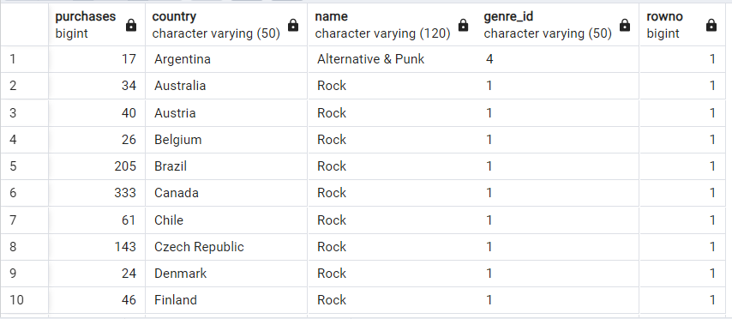
Q2: We want to find out the most popular music Genre for each country. We determine the most popular genre as the genre with the highest amount of purchases. Write a query that returns each country along with the top Genre. For countries where the maximum number of purchases is shared return all Genres.
OUTPUT

Slide 19
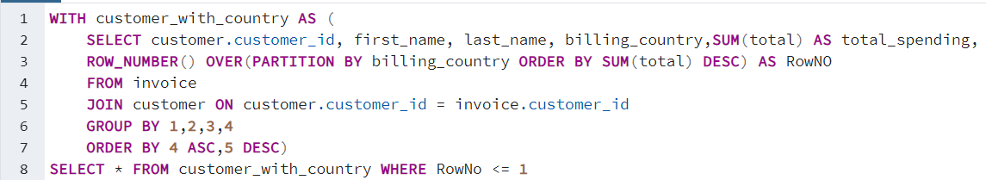
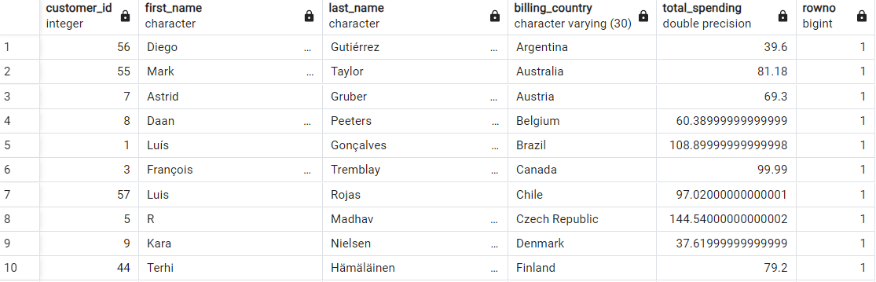
Q3: Write a query that determine the customer that has spent the most on music for each country. Write a query that returns the country along with the top customer and how much they spent. For countries where the top amount spent is shared, provide all customers who spent this amount.
QUE NO-3

Slide 20
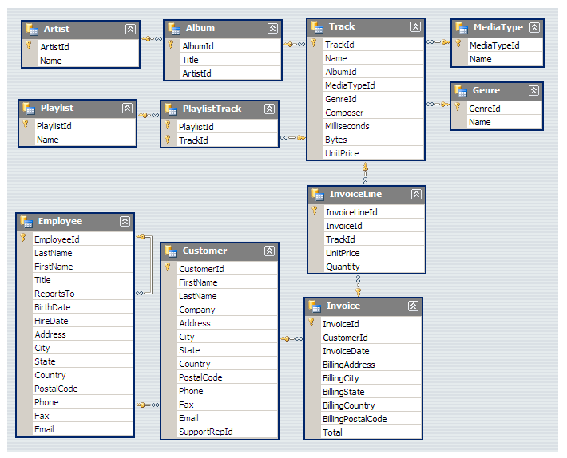
SCHEMA

Slide 21
ADVANCE QUERIES
THANK YOU

